Slide 1
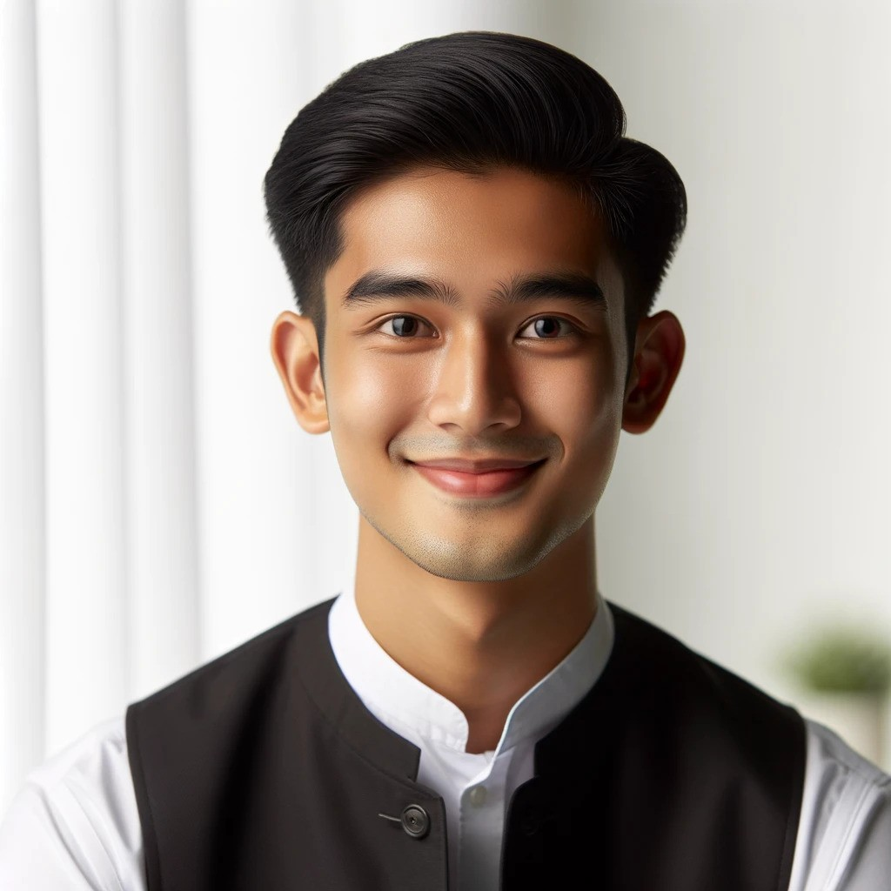
I DEWA PUTU SURYA
Curriculum Vitae
+62 361-876-5432
P R O F I L E
dewaputu@mail.com
A highly motivated and detail-oriented professional seeking a challenging position in the hospitality industry where I can utilize my mixology skills and customer service experience to contribute to the success of the team and further develop my career.
dewaputu.ltd
Jl. Raya Ubud No. 45, Ubud, Bali, Indonesia
S K I L L S
E X P E R I E N C E
Communication Skills:
Bartender,
• Verbal communication
Tropical Breeze Bar, Ubud, Bali
• Written communication
June 2022 – June 2024
• Active listening
Responsibility/Accomplishment: Crafted and served a wide variety of cocktails and beverages, ensuring high-quality standards. Developed new cocktail recipes, increasing customer satisfaction and repeat visits.
Teamwork Skills:
• Collaboration
• Conflict resolution
• Team leadership
Assistant Bartender
Ocean View Lounge, Kuta, Bali
E D U C A T I O N
January 2021 – May 2022
Bali Culinary and
Hospitality School
Responsibility/Accomplishment: Assisted the head bartender in preparing drinks and maintaining a clean bar area. Provided excellent customer service, creating a welcoming environment for guests. Trained new staff on bar operations and customer service techniques.
Certificate in Mixology
and Bartending
Graduated: June 2022
Intern
Udayana University
Bali
Bali Hospitality Group, Seminyak, Bali
June 2020 – December 2020
Bachelor of Tourism
Management
Responsibility/Accomplishment: Assisted in the daily operations of the bar, including inventory management and customer service. Learned and applied mixology techniques under the supervision of senior bartenders.
Graduated: June 2021

