Slide 1
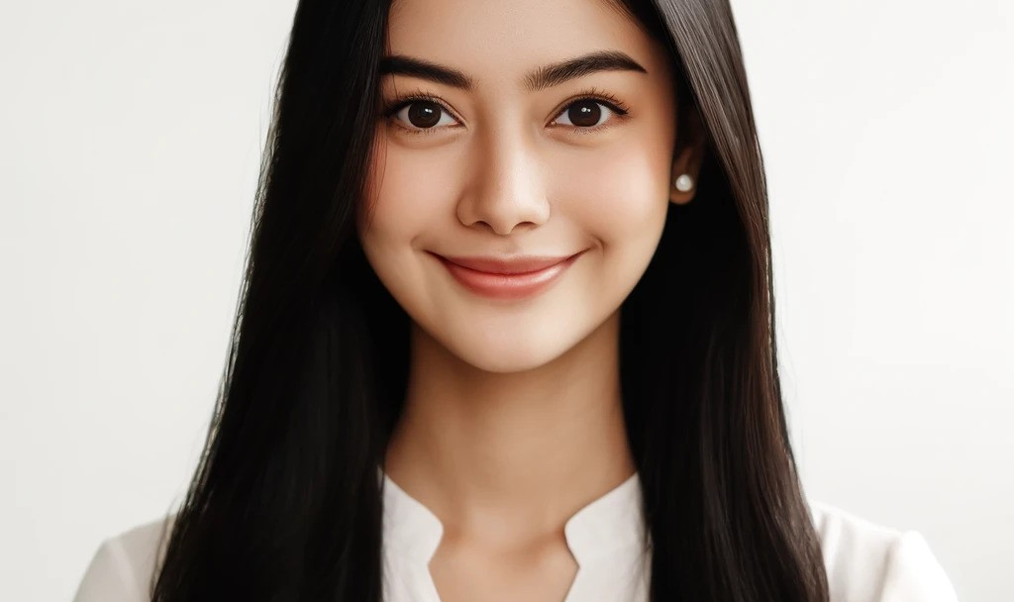
Ayu Wulandari
Curriculum Vitae
+62 361-876-5432
About Me
ayuwulandari@mail.id
Seeking a Spa Therapist role where I can leverage my massage therapy skills, holistic health knowledge, and customer service experience to contribute effectively to a wellness center, while continuing to learn and grow in a dynamic work environment.
Jl. Raya Ubud No. 45, Ubud, Bali, Indonesia
Education
Work Experience:
Diploma in Spa Therapy
Spa Therapist
June 2022 - Present
Bali Spa and Wellness Academy
Heavenly Spa, Ubud, Bali
Graduation Year: 2022
Provided a variety of spa services, including massages, facials, and body treatments, ensuring client satisfaction.
Assessed client needs and recommended appropriate treatments.
Maintained a clean and organized work environment, adhering to health and safety standards.
Certificate in Holistic Health
Indonesian Institute of Holistic Health
Graduation Year: 2020
Massage Therapist
Expertise
January 2021 - May 2022
Serenity Wellness Center, Seminyak, Bali
Massage Therapy
Conducted various massage techniques, including Swedish, deep tissue, and reflexology.
Created personalized treatment plans based on client preferences and health conditions.
Received positive feedback for exceptional customer service and therapeutic skills.
Aromatherapy
Reflexology
Skincare Treatments
Customer Service Skills
Spa Intern
Communication Skills
June 2020 - December 2020
Bali Wellness Retreat, Denpasar, Bali
Language
Assisted senior therapists in providing spa treatments.
Learned and practiced various spa and wellness techniques.
Ensured the cleanliness and readiness of treatment rooms.
Indonesian
English
References
I Made Wijaya
Ni Luh Putri
Heavenly Spa - Spa Manager
Wellness Director - Serenity Center
Phone: +62 361-123-4567
Phone: +62 361-987-6543
Email: made.wijaya@mail.com
Email: ni.luh.putri@mail.com

