Slide 1
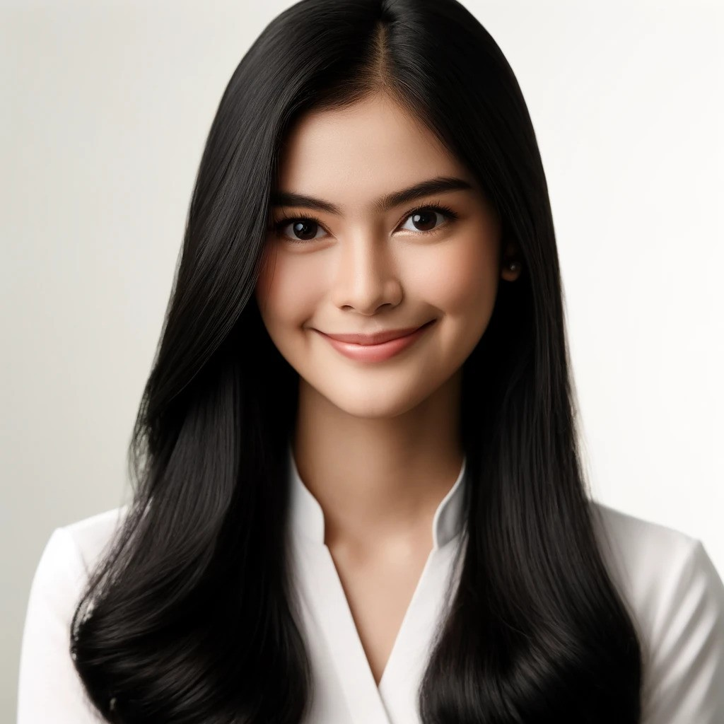
PUTU RAHAYU
Curriculum Vitae
PROFILE SUMMARY:
Dedicated and passionate professional with 5 years of experience in front office management and customer service. Committed to creating a welcoming and efficient environment for guests while managing administrative tasks and coordinating with various departments. Proficient in leveraging technology to enhance front office operations and provide exceptional guest experiences.
CONTACT:
Phone: +62 361-876-5432
Email: puturahayu@mail.id
Address: Jl. Raya Ubud No. 45, Ubud, Bali, Indonesia
EDUCATION:
LinkedIn: /puturahayu
Diploma in Hospitality Management
KEY SKILLS:
• Bali Tourism Institute, Denpasar, Bali
• 2015 - 2018
• Front Office Management
• Customer Service
• Administrative Tasks
• Reservation Management
• Technology Integration
• Communication Skills
• Adaptability
• Leadership and Collaboration
MASTER OF ARTS IN TEACHING (MAT)
• Crossville, Tennessee
• 2016 - 2018
• Special Education
WORK EXPERIENCE:
TECHNICAL
SKILLS:
Front Office Manager
• Bali Paradise Hotel, Ubud
• 2021 - Present
• Reservation Software
• Microsoft Office Suite
• Google Suite
• Video Conferencing Tools
• Digital Presentations
• Internet Research
Managed front office operations, ensuring smooth check-in and check-out processes.
Supervised a team of front desk staff, providing training and support to enhance service quality.
Handled guest inquiries and complaints, ensuring timely and satisfactory resolution.

Slide 2
PUTU RAHAYU
Curriculum Vitae
WORK EXPERIENCE:
Front Desk Agent
Serenity Beach Resort, Kuta
2018 - 2021
CONTACT:
Assisted guests with reservations, check-ins, and check-outs.
Provided information about hotel services, local attractions, and travel arrangements.
Maintained accurate records of room availability and guest accounts.
Phone: +1 931-707-4231
Email: puturahayu@mail.id
Address: Jl. Raya Ubud No. 45, Ubud, Bali, Indonesia
LinkedIn: /puturahayu
LANGUAGE
PROFICIENCY:
CERTIFICATIONS AND LICENSES:
• Indonesian: Native proficiency
• English: Advanced proficiency
Certificate in Front Office Operations
• Bali Tourism Institute, 2018
Hospitality Management Certification
• Indonesian Hotel and Restaurant Association, 2019

Slide 3
PUTU RAHAYU
Curriculum Vitae
COVER LETTER
Today's Date: 25 - 05 - 2024
Hiring Manager's Name: Ibu Ayu Widjaja
CONTACT:
Hotel Name: Bali Paradise Hotel
Hotel Address: Jl. Raya Ubud No. 123, Ubud, Bali, 80571
Phone: +1 931-707-4231
Email: puturahayu@mail.id
Dear Ibu Ayu Widjaja,
Address: Jl. Raya Ubud No. 45, Ubud, Bali, Indonesia
LinkedIn: /puturahayu
I am writing to express my genuine interest in the Front Office Manager position at Bali Paradise Hotel, as advertised. With a passion for delivering exceptional customer service and a commitment to creating a welcoming atmosphere, along with over 5 years of experience in front office operations, I am excited about the prospect of contributing my skills and dedication to your esteemed hotel.
In my previous role as a Front Desk Agent at Serenity Beach Resort, I developed a comprehensive understanding of reservation management, guest relations, and administrative tasks. I strongly believe in maintaining high standards of professionalism and efficiency to ensure a seamless experience for all guests. My current role as Front Office Manager at Bali Paradise Hotel has further honed my abilities in team supervision, conflict resolution, and operational management.
Enclosed is my resume that further outlines my qualifications. I would welcome the opportunity to discuss how my skills align with the needs of Bali Paradise Hotel. Thank you for considering my application. I am looking forward to the possibility of contributing to the exceptional service at Bali Paradise Hotel.
Warm regards,
Putu Rahayu
Putu Rahayu

Slide 4
PUTU RAHAYU
Curriculum Vitae
REFERENCES:
I Made Wijaya
Position: Spa Manager
CONTACT:
Institution/Organization: Heavenly Spa
Contact Information: +62 361-123-4567
Phone: +1 931-707-4231
Ni Luh Putri
Email: puturahayu@mail.id
Position: Wellness Director
Address: Jl. Raya Ubud No. 45, Ubud, Bali, Indonesia
Institution/Organization: Serenity Wellness Center
LinkedIn: /puturahayu
Contact Information: +62 361-987-6543
Agus Santoso
Position: Front Office Supervisor
Institution/Organization: Bali Paradise Hotel
Contact Information: +62 361-456-7890
Kadek Surya
Position: General Manager
Institution/Organization: Serenity Beach Resort
Contact Information: +62 361-678-9012
Putu Ayu
Position: Head of Housekeeping
Institution/Organization: Bali Paradise Hotel
Contact Information: +62 361-789-0123

