Slide 1
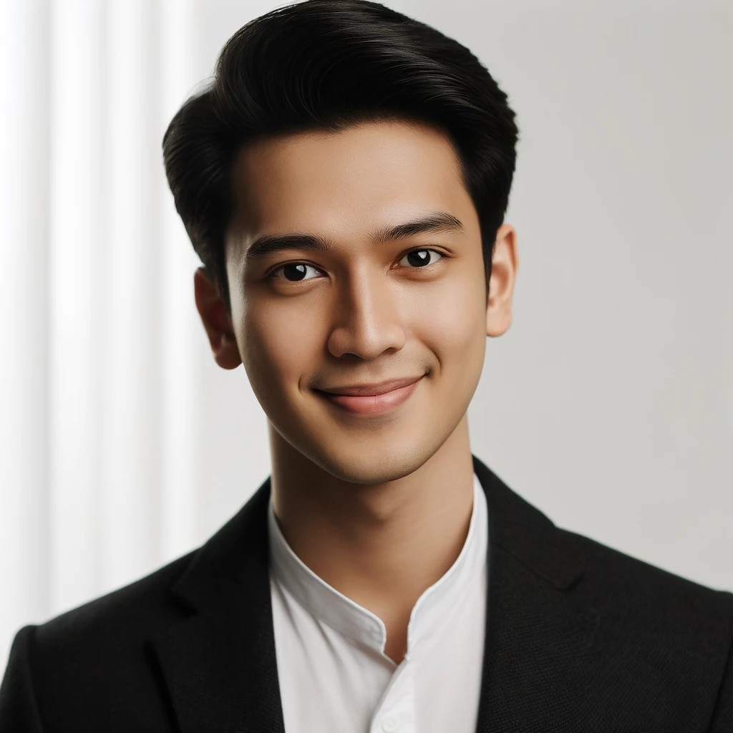
MADE SURYA
Graphic Designer
CONTACT
OBJECTIVE
Location:
Highly creative and detail-oriented Graphic Designer with a passion for visual storytelling and brand development. Seeking to leverage my expertise in graphic design to contribute to the success of a dynamic organization.
Jl. Raya Ubud No. 45, Ubud, Bali, Indonesia
Phone:
+62 361-876-5432
Email:
SKILLS
madesurya.design@mail.id
Proficient in Adobe Creative Suite (Photoshop, Illustrator, InDesign)
EDUCATION
Strong understanding of typography, color theory, and layout design
Bachelor of Fine Arts
Ability to conceptualize and execute innovative design solutions
in Graphic Design
Experience in branding, logo design, and marketing materials
Bali School of Design, Denpasar, Bali
Knowledge of print and digital design best practices
Graduated: May 2022
PORTFOLIO
EXPERIENCE
Link to online portfolio:
GRAPHIC DESIGNER Bali Creative Studio, Denpasar
www.madesuryaportfolio.com
January 2023 - Present
Collaborated with clients to conceptualize and create custom designs for branding, marketing collateral, and digital assets.
REFERENCES
Produced engaging visual content for social media, websites, and email campaigns.
Available upon request.

Slide 2
MADE SURYA
Graphic Designer
CONTACT
EXPERIENCE
Location:
JUNIOR GRAPHIC DESIGNER Ubud Art Studio, Ubud
Jl. Raya Ubud No. 45, Ubud, Bali, Indonesia
June 2022 - December 2022
Phone:
Assisted senior designers in creating design layouts and graphics for various projects.
+62 361-876-5432
Conducted research on design trends and provided input on creative direction.
Email:
Developed skills in Adobe Creative Suite and gained experience in a fast-paced design environment.
madesurya.design@mail.id
EDUCATION
GRAPHIC DESIGN INTERN Kuta Media Agency, Kuta
January 2021 - May 2022
Bachelor of Fine Arts
Supported the design team with the creation of marketing materials and visual content.
in Graphic Design
Bali School of Design, Denpasar, Bali
Participated in brainstorming sessions to develop creative concepts for client campaigns.
Graduated: May 2022
PORTFOLIO
Assisted with photo editing, illustration, and layout design tasks.
Link to online portfolio:
Gained hands-on experience in a professional design environment and improved technical skills.
www.madesuryaportfolio.com
REFERENCES
Available upon request.

Slide 3
MADE SURYA
Graphic Designer
CONTACT
Dear Ayu Lestari,
Location:
I am writing to express my interest in the Graphic Designer position advertised by Bali Creative Minds Foundation. With a Bachelor of Fine Arts in Graphic Design from Bali School of Design and extensive experience in branding, marketing collateral, and digital assets, I am excited about the opportunity to contribute to your team.
Throughout my career, I have participated in numerous design projects where I have been able to showcase my creativity and versatility as a designer. My experience has taught me the importance of effective communication and collaboration in the creative process.
I am particularly drawn to Bali Creative Minds Foundation because of its commitment to innovative and impactful design initiatives. I am eager to bring my skills and experiences to your team and contribute to the continued success of your organization.
Thank you for considering my application. I look forward to the opportunity to discuss how my background, skills, and passion for design align with the needs of Bali Creative Minds Foundation. Please find my resume attached for your review.
Jl. Raya Ubud No. 45, Ubud, Bali, Indonesia
Phone:
+62 361-876-5432
Email:
madesurya.design@mail.id
Ayu Lestari
Location:
Jl. Raya Ubud No. 45, Ubud, Bali, Indonesia
Phone:
Warm regards,
(678) 789-3458
Email:
Made Surya
ayu.lestari@email.com

Slide 4
MADE SURYA
Graphic Designer
CONTACT
REFERENCES
Location:
Ayu Lestari
Jl. Raya Ubud No. 45, Ubud, Bali, Indonesia
Position: Director of Engagement
Company: Creative Minds Foundation
Phone:
Phone: +62 361-678-9012
+62 361-876-5432
Email: ayu.lestari@creative.com
Email:
Kadek Putra
madesurya.design@mail.id
Position: Gallery Assistant
Company: Unity Gallery
Phone: +62 361-930-1234
EDUCATION
Email: kadek.putra@design.com
Bachelor of Fine Arts
Wayan Sudarma
Position: Lead Artist
in Graphic Design
Company: Spectrum Art Studios
Bali School of Design, Denpasar, Bali
Phone: +62 361-789-0123
Email: wayan.sudarma@spectrumart.com
Graduated: May 2022
Gede Wijaya
Position: Art Collector
PORTFOLIO
Company: Spectrum Art Studios
Phone: +62 361-012-3456
Link to online portfolio:
Email: gede.wijaya@example.com
www.madesuryaportfolio.com

