Slide 1
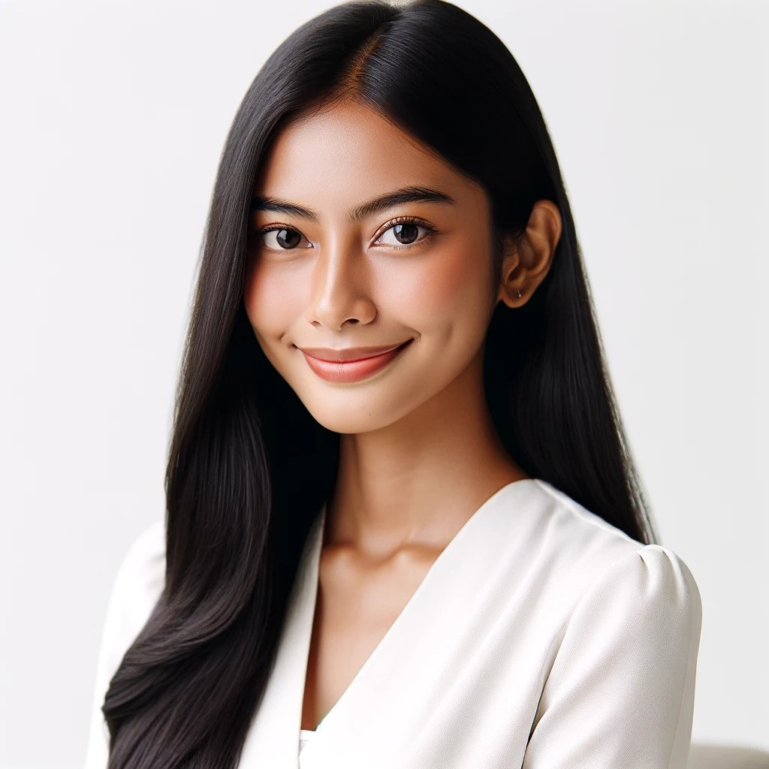
NI MADE
DEWI SUKMA
Phone: +62 361-876-5432
Email: dewisu@mail.com
Linkedin: linkedin.com/in/dewisu/
Address: Jl. Raya Ubud No. 45, Ubud, Bali, Indonesia
CURRICULUM VITAE
SUMMARY
Highly motivated and detail-oriented professional with over 5 years of experience in housekeeping and hospitality. Proficient in maintaining cleanliness and organization to ensure guest satisfaction. Seeking a challenging position where I can utilize my skills and contribute to the success of the team.
EDUCATION
Diploma in Hospitality Management
Bali Tourism Institute
Completion - 2021
High School Diploma
SMA Negeri 1 Ubud
Graduation - 2018
WORK EXPERIENCE
July 2021 - Present
Housekeeping Supervisor
Bali Paradise Resort, Ubud, Bali
Key Qualifications and Responsibilities
• Supervised a team of housekeeping staff to maintain high standards of cleanliness and service.
• Conducted regular inspections to ensure all guest rooms and public areas met hotel standards.
• Trained new employees on proper cleaning techniques and safety protocols.
May 2019 - June 2021
Housekeeper
Sunset Villas, Seminyak, Bali
Key Qualifications and Responsibilities
• Performed cleaning duties in guest rooms, lobbies, and other public areas.
• Ensured all rooms were stocked with necessary supplies and amenities.
• Responded promptly to guest requests and resolved any issues efficiently.

Slide 2
NI MADE
DEWI SUKMA
Phone: +62 361-876-5432
Email: dewisu@mail.com
Linkedin: linkedin.com/in/dewisu/
Address: Jl. Raya Ubud No. 45, Ubud, Bali, Indonesia
CURRICULUM VITAE
CORE COMPETENCIES
• Attention to Detail
• Time Management
• Customer Service
• Team Collaboration
• Problem Solving
CERTIFICATIONS
• Certificate in Housekeeping Operations, Bali Tourism Institute, 2018
• Food Safety and Hygiene Certification, 2017
AWARDS
• Employee of the Month, Bali Paradise Resort, August 2022
• Best Housekeeping Staff, Sunset Villas, December 2020
MEMBERSHIPS
• Bali Hospitality Association (BHA)
LANGUAGES
• Indonesian: Native speaker
• English: Professional Working Proficiency

Slide 3
NI MADE
DEWI SUKMA
Phone: +62 361-876-5432
Email: dewisu@mail.com
Linkedin: linkedin.com/in/dewisu/
Address: Jl. Raya Ubud No. 45, Ubud, Bali, Indonesia
CURRICULUM VITAE
COVER LETTER
Stanton Dicki
Hiring Manager
Sunset Villas
Jl. Raya Seminyak No. 123
Seminyak, Bali, 80361
hire@sunsetvillas.com
+62 361-987-6543
March 2025
Dear Mr. Stanton Dicki
I am writing to express my interest in the Housekeeping position advertised on your company’s website. With a diploma in Hospitality Management and over 5 years of experience in the housekeeping industry, I am confident in my ability to contribute effectively to your team.
In my current role as a Housekeeping Supervisor at Bali Paradise Resort, I have developed strong skills in team leadership, attention to detail, and customer service. I have successfully supervised a team of housekeeping staff, ensuring high standards of cleanliness and guest satisfaction. My ability to train new employees and conduct regular inspections has significantly improved our service quality.
I am particularly impressed with Sunset Villas' commitment to providing exceptional guest experiences. I am eager to bring my skills and dedication to your esteemed establishment. Thank you for considering my application. I look forward to the possibility of contributing to Sunset Villas' success
Thank you for your consideration.
Yours Sincerely,
Dewi Sukma

Slide 4
NI MADE
DEWI SUKMA
Phone: +62 361-876-5432
Email: dewisu@mail.com
Linkedin: linkedin.com/in/dewisu/
Address: Jl. Raya Ubud No. 45, Ubud, Bali, Indonesia
CURRICULUM VITAE
REFERENCES
Priscilla Wibowo
General Manager
Bali Paradise Resort
+62 361-123-4567
priscilla.wibowo@mail.com
Rini Santoso
Housekeeping Manager
Sunset Villas
+62 361-987-6543
rini.santoso@mail.com
Agus Widjaja
Operations Manager
Ubud Bungalow
+62 361-789-0123
agus.widjaja@mail.com
Made Suryani
Professor of Hospitality Management
Bali Tourism Institute
+62 361-456-7890
made.suryani@mail.com

