Slide 1
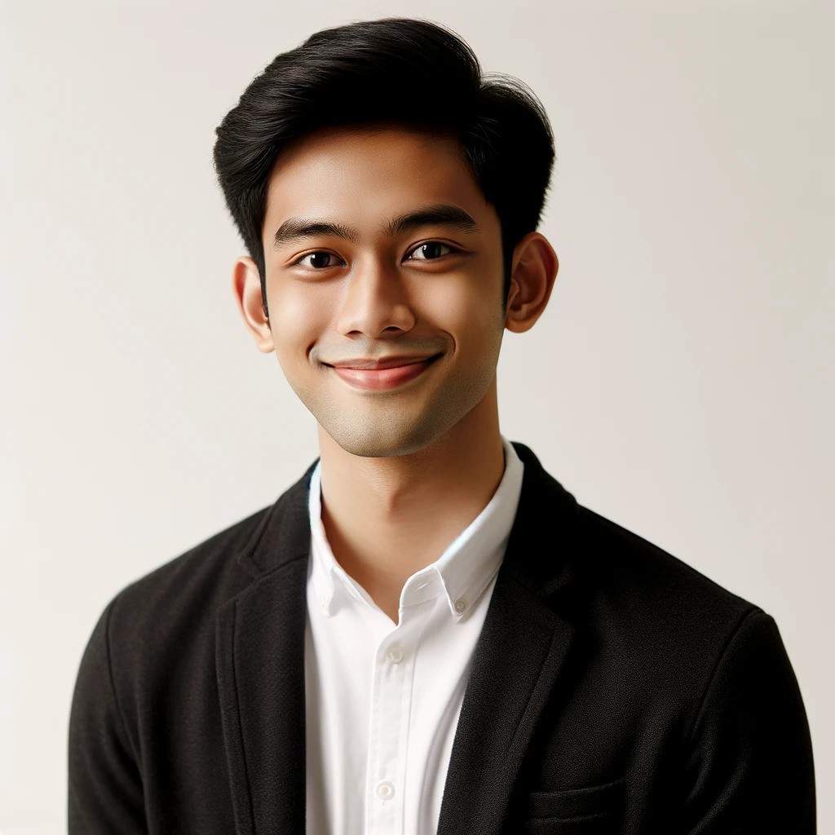
Kadek
Wijaya
OBJECTIVE :
Dedicated and enthusiastic tourism management professional with over 5 years of experience in the hospitality and tourism industry. Proven track record of enhancing customer satisfaction and operational efficiency. Seeking a challenging role where I can apply my skills in project management, strategic planning, and customer service to contribute to the success of a dynamic organization.
CONTACT
+62 361-123-4567
kadek.wijaya@mail.com
kadekwijaya.id
Jl. Sunset Road No. 88, Kuta, Bali, Indonesia
WORK EXPERIENCE
EDUCATION
Tour Manager
January 2020 - May 2024
Bali Travel Co., Denpasar
Bachelor of Tourism Management,
Led tours for international tourists, increasing customer satisfaction by 20%.
Udayana University, Bali
2014 - 2018
Guest Relations Officer
June 2018 - December 2019
The Oberoi, Seminyak, Bali
Diploma in Hospitality Management
Managed guest inquiries and complaints, achieving a 95% positive feedback rating.
Bali Tourism Institute
Front Desk Agent
July 2014 - May 2018
2012 - 2014
Hard Rock Hotel, Kuta, Bali
SKILLS
Coordinated check-ins and check-outs, improving front desk efficiency by 15%.
Project Management
REFERENCES
Data Analysis
Ni Made Suartini
Agus Widjaja
Strategic Planning
Tour Guide Manager
General Manager
Team Leadership
Phone: +62 361-123-4568
Phone: +62 361-123-4569
Communication Skills
Email: made.suartini@mail.com
Email: agus.widjaja@mail.com
Customer Service
I Ketut Arjana
Multilingual: Bahasa Indonesia, English, Japanese
Director of Operations
Phone: +62 361-123-4570
Email: ketut.arjana@mail.com

